Slide 1
IOT Analytics Deep Dive – SubMetering Data
Michelle Giniewicz September 25, 2022

Slide 2
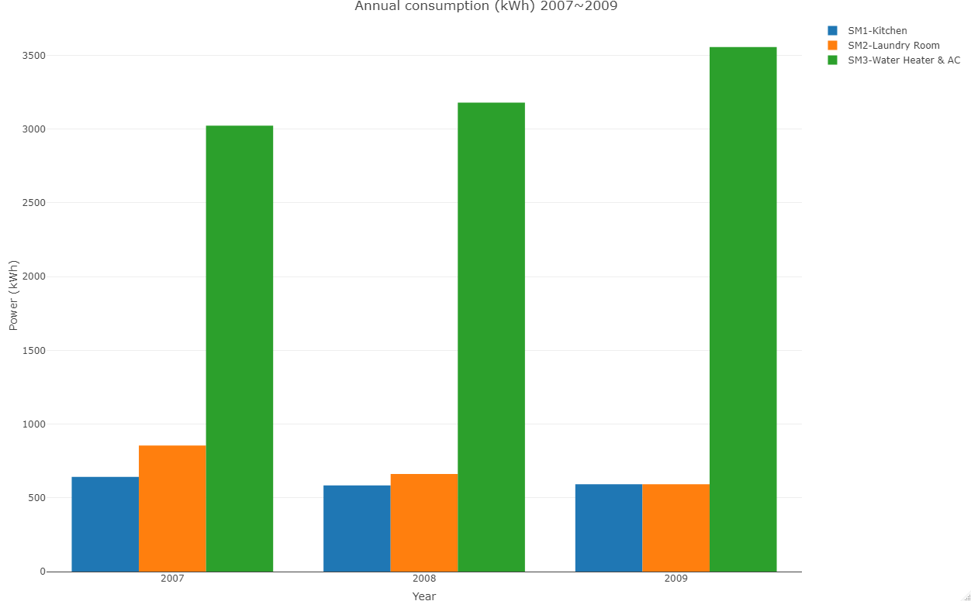
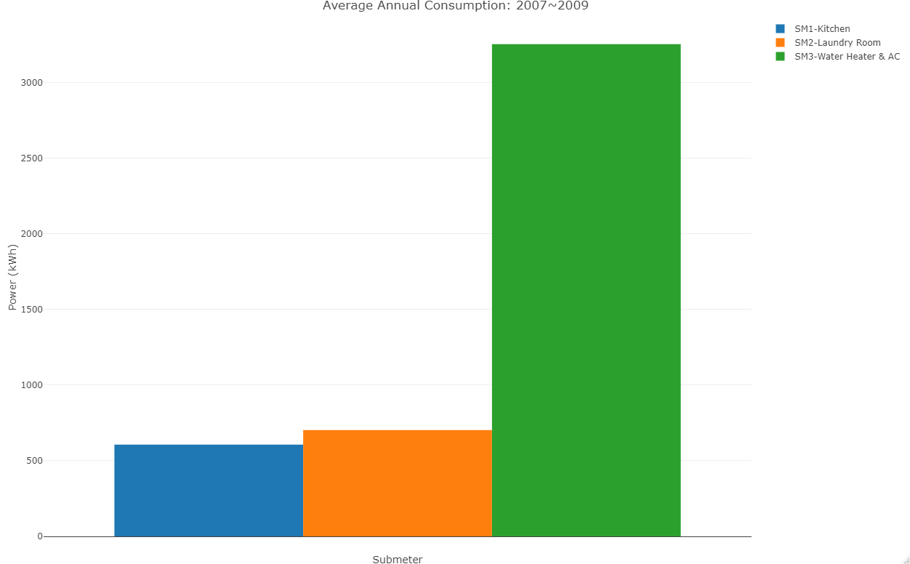
Annual consumption by submeter
Submeter 3 (Water Heater & AC) use significantly more power than the other two Submeters, with an average of over 3000 kWh
Submeter 2 (Laundry Room) is the second highest power consumer, followed by Submeter 1 (Kitchen)
There is not a significant difference between the power consumption of Submeter 2 (Laundry Room) and Submeter 3 (Kitchen)

Slide 3
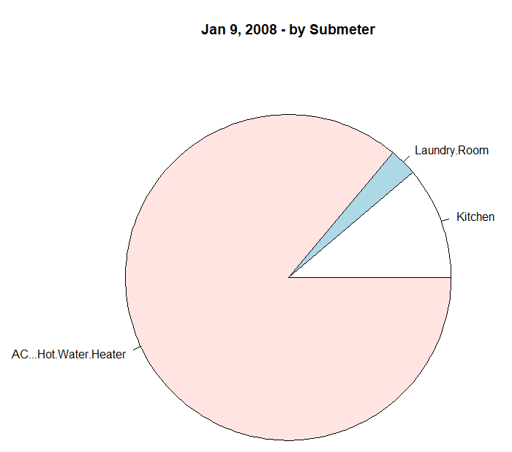
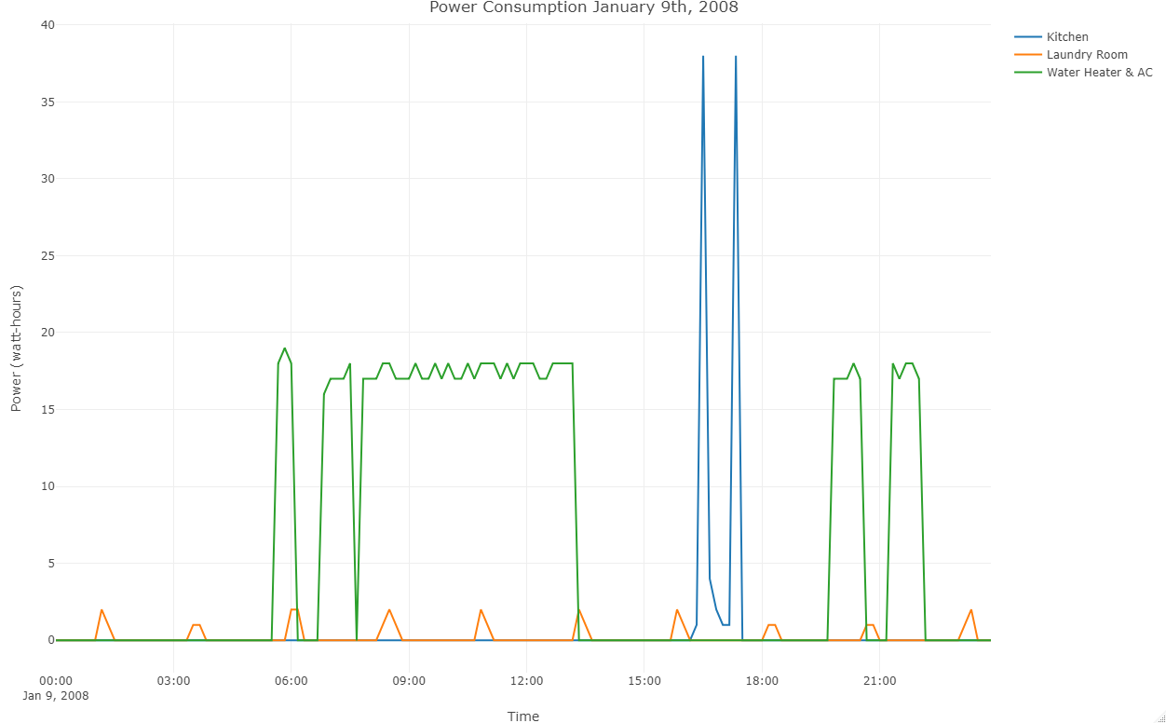
Daily Power Consumption – Jan 9, 2008
This chart shows consumption data in 10-minute increments for January 9, 2008
The "Water Heater & AC" peak from 7:50 - 13:10 is the hot water heater.
Hot water heaters typically run from 3-5 hours/day.
The multiple short peaks that last around 30 minutes are when the AC is running.
The peaks in the laundry room are from the refrigerator.
Kitchen appliances were used twice during this day, between 16:30-17:00.

Slide 4
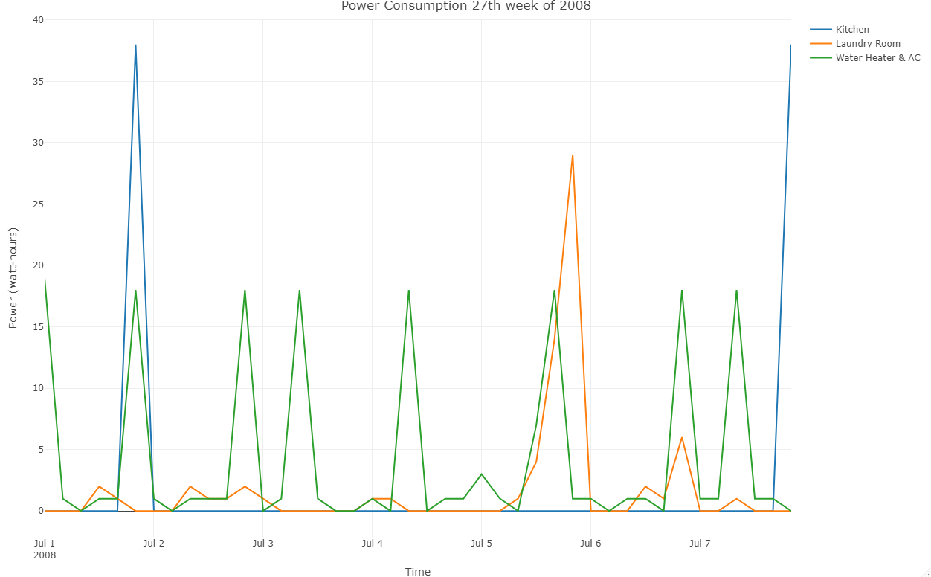
Weekly Power Consumption – July 1-7, 2008
This chart shows consumption data from every 4 hours for the 27th week of 2008 (July 1-7)
The "Water Heater & AC" consumptions is fairly consistent across days of the week
The Kitchen has higher consumption during the week, with very low consumption on the weekend (July 5-6)
The Laundry Room has higher consumption on the weekend (July 5-6), when people are more likely to wash clothes

Slide 5
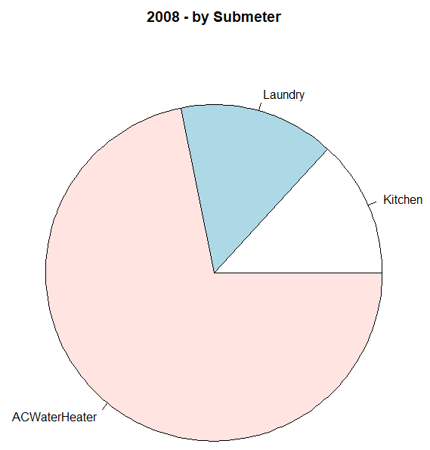
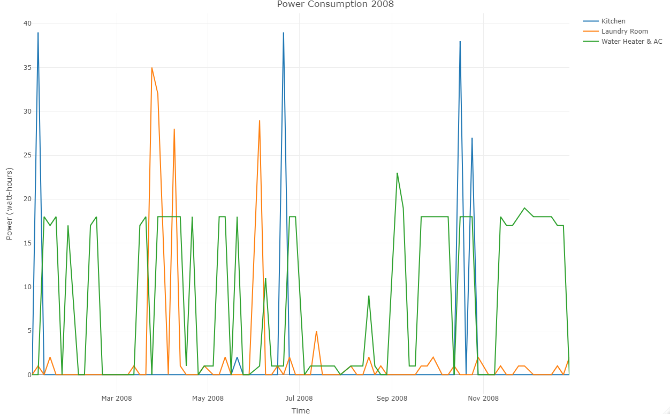
Annual Power Consumption –2008
This chart shows consumption data every 4 days at 12:00pm for all of 2008
There is overall less power consumption during the summer months (July-August), especially for the Water Heater & AC
The Laundry Room had higher consumption in the spring/summer (March-June)
The Kitchen has higher consumption in January, July, and October
This may be due to the sample of data only looking at 12:00pm consumption, when most people are not home during the weekdays

Slide 6
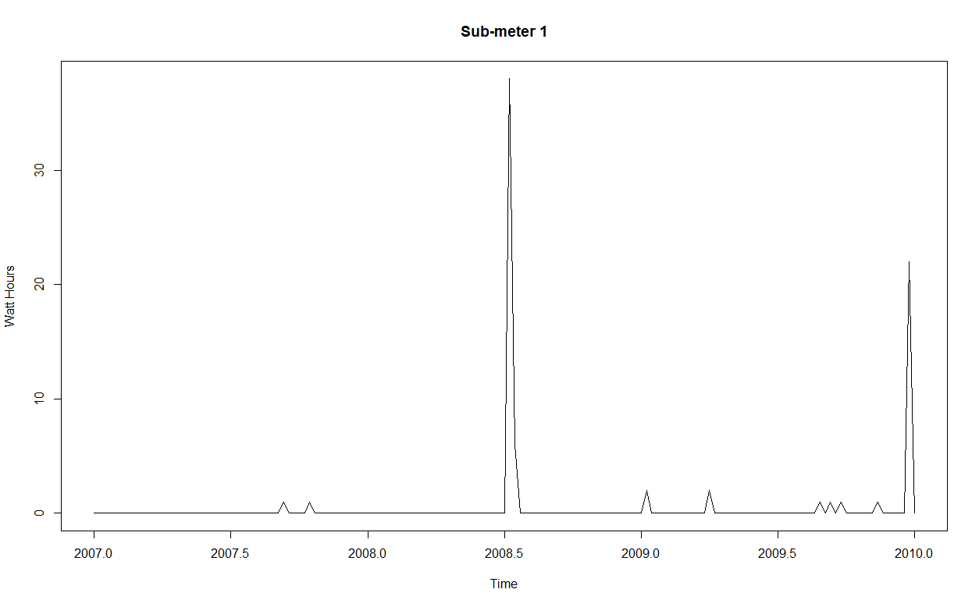
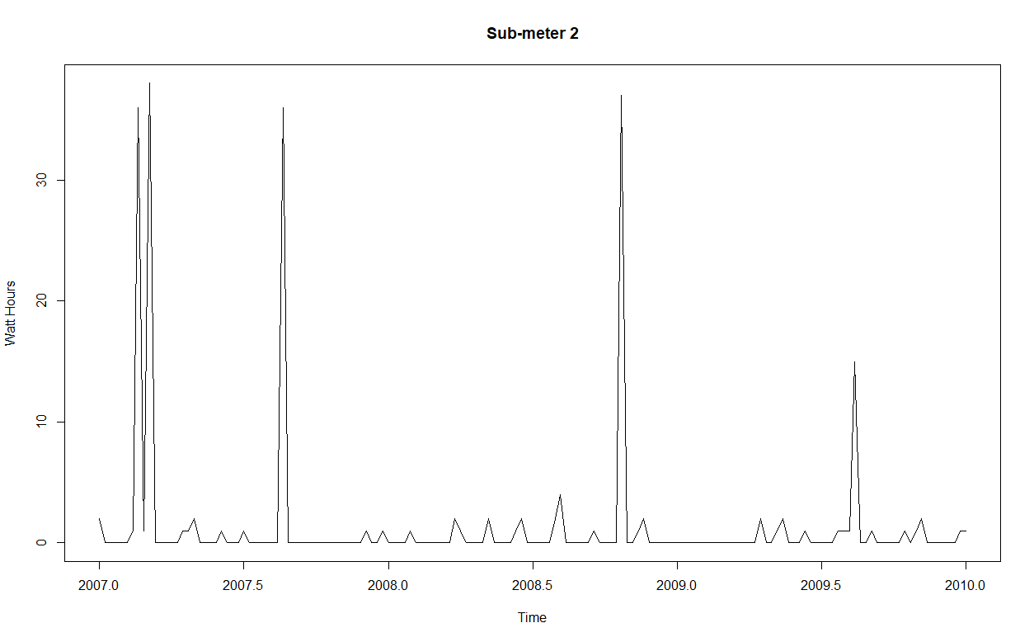
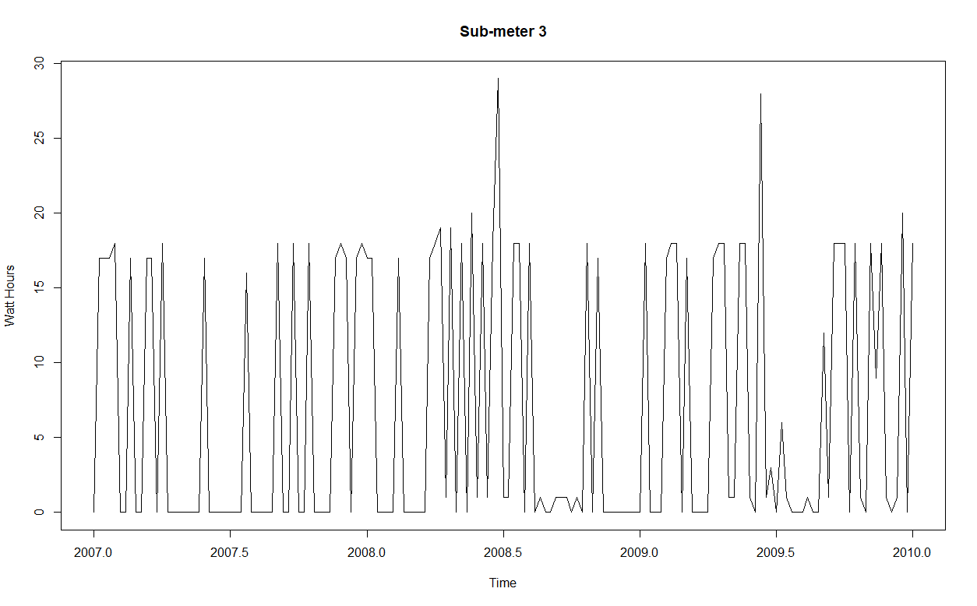
Time-series visualizations – by submeter
Charts show consumption of:
Submeter 1 (Kitchen)
Submeter 2 (Laundry Room)
Submeter 3 (Water Heater & AC)
Time series is based only on data from Mondays at 8:00pm for 2007-2009

Slide 7
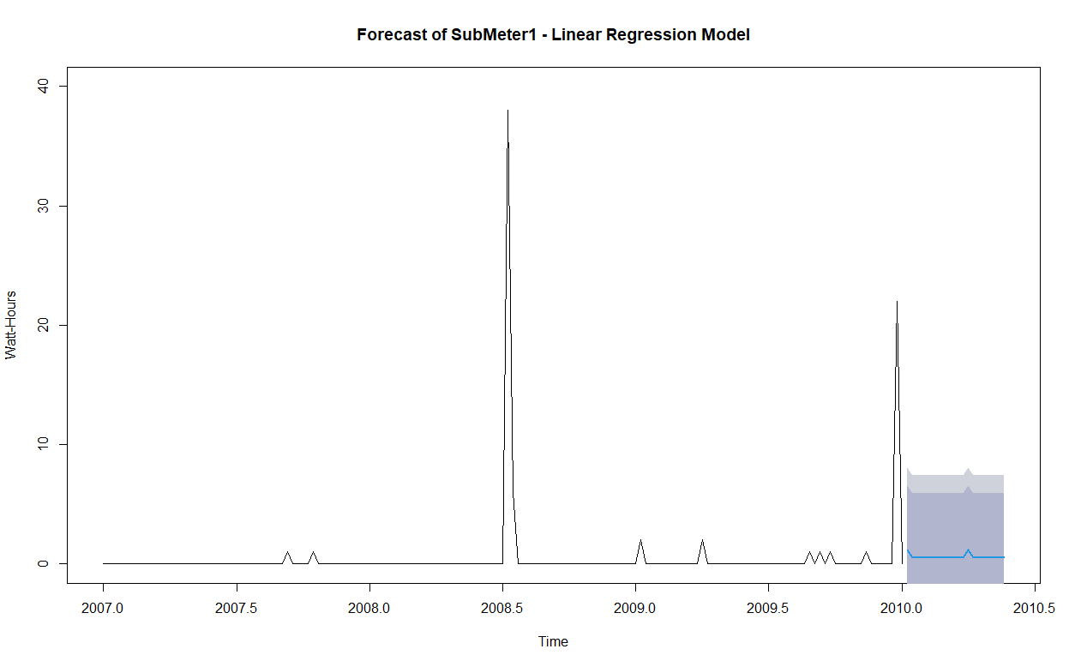
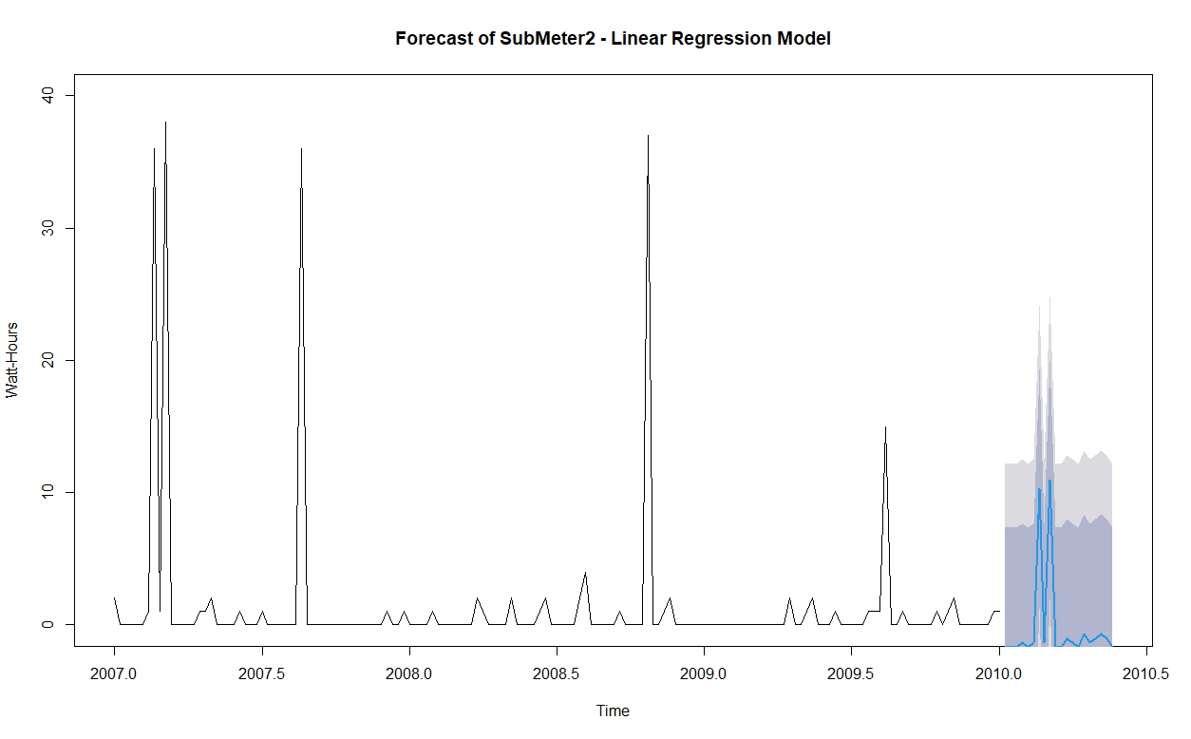
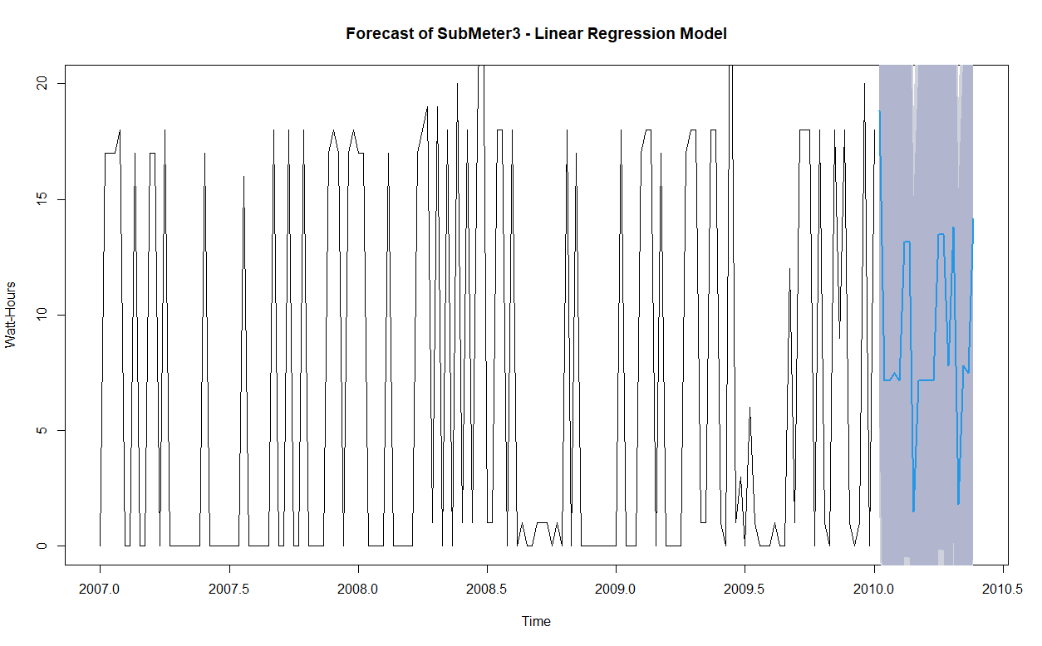
Linear regression forecasting – by submeter
Model | RMSE | Multiple R2 | Adjusted R2
SubMeter1 | 3.55 | 0.3248 | -0.01278
SubMeter2 | 5.98 | 0.3152 | -0.02725
SubMeter3 | 9.046 | 0.263 | -0.1055
These charts show forecasting of 20 periods in the future by Submeter
Original data is based only on data from Mondays at 8:00pm for 2007-2009

Slide 8
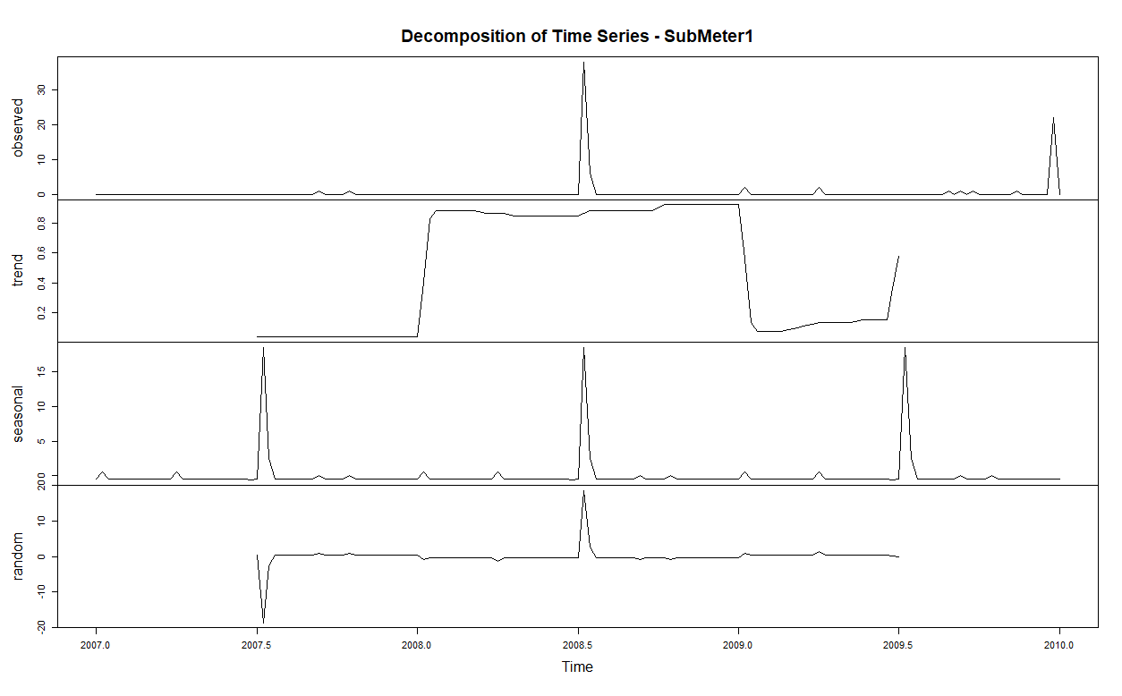
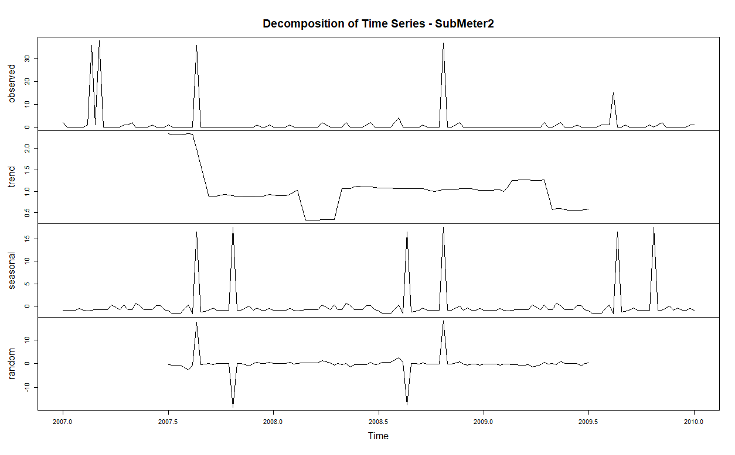
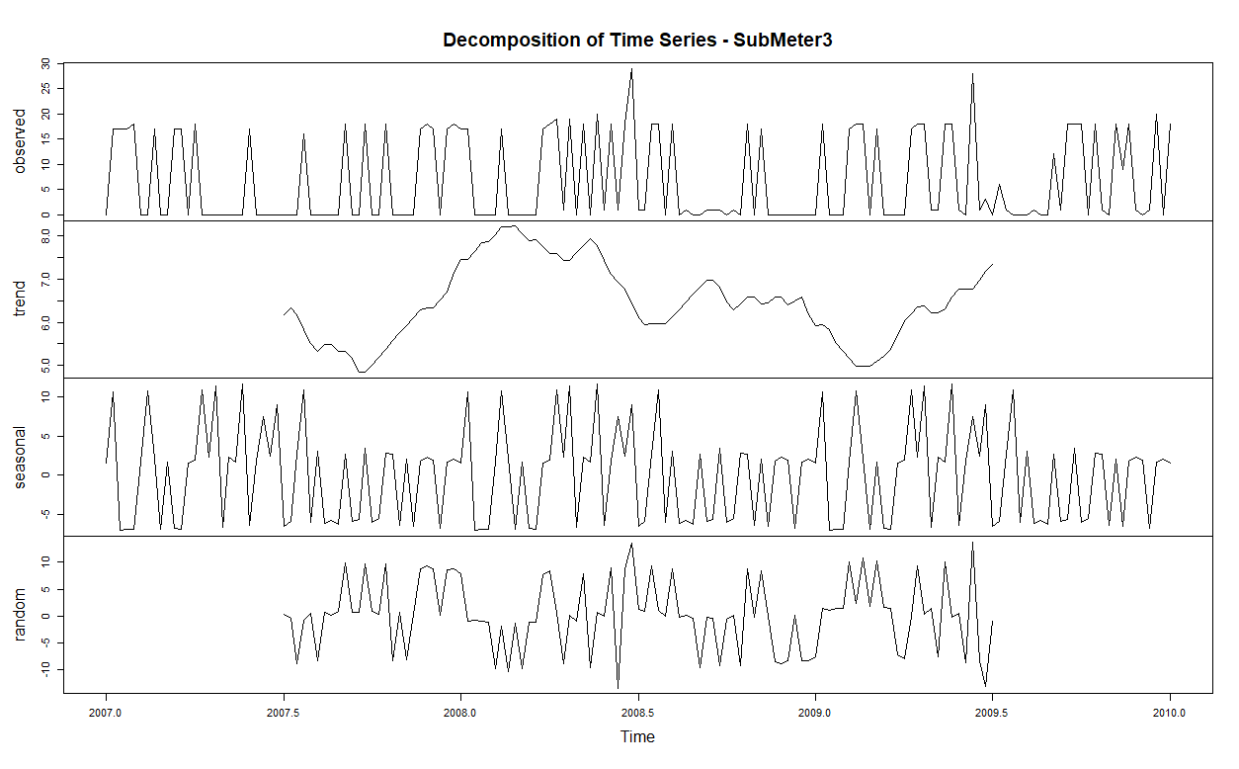
Decomposition visualizations – by submeter
 | Component | Min | Mean | Max
SubMeter1 | Seasonal | -0.603427 | -0.003047 | 18.550419
 | Trend | 0.03846 | 0.48315 | 0.92308
 | Random | -18.58888 | -0.00234 | 18.58420
SubMeter2 | Seasonal | -1.633937 | -0.005783 | 17.592024
 | Trend | 0.3269 | 1.0292 | 2.3269
 | Random | -18.48625 | -0.05837 | 18.36951
SubMeter3 | Seasonal | -6.96934 | 0.01015 | 11.59797
 | Trend | 4.837 | 6.456 | 8.231
 | Random | -13.357 | 0.2241 | 13.8059
These charts decompose time series into trend, seasonal, and irregular components
Each Submeter has seasonal peaks, which we will account for on Slides 9-11
Data is based only on consumption from Mondays at 8:00pm for 2007-2009

Slide 9
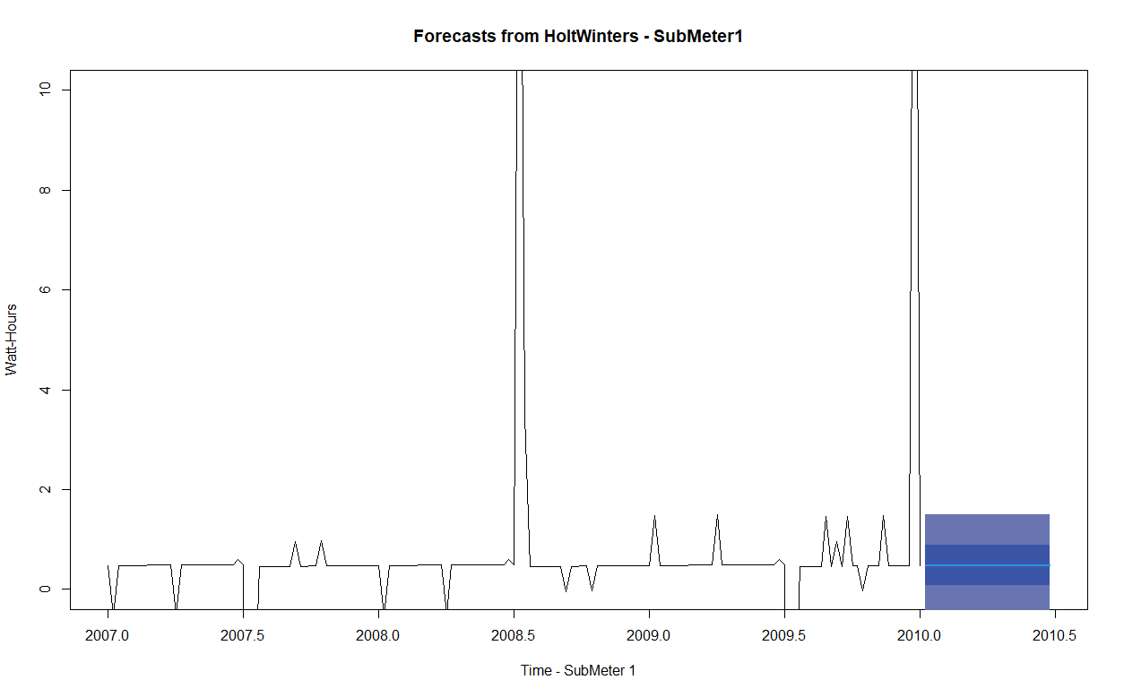
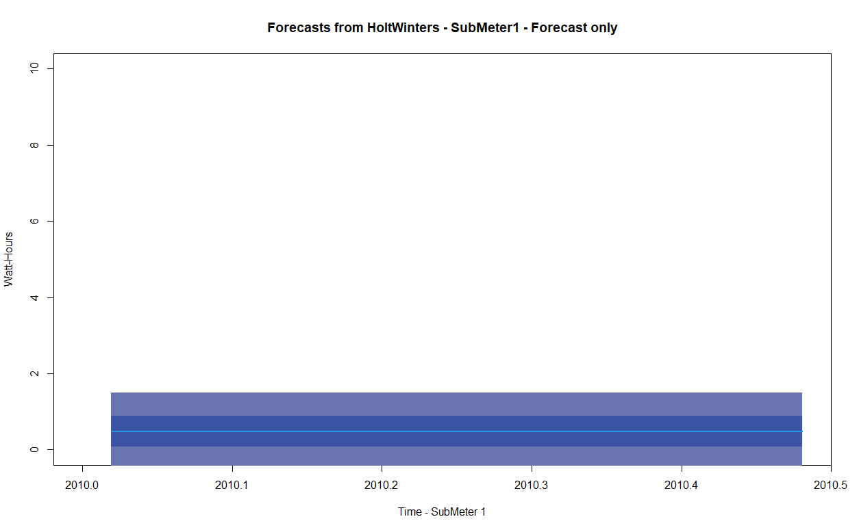
Holt-winters forecasting – submeter 1
These charts show the adjusted forecast for Submeter 1 (Kitchen), after removing the seasonal component
Charts show confidence level of 10 (the dark blue area) and 25 (the light blue area)
Original data is based only on data from Mondays at 8:00pm for 2007-2009

Slide 10
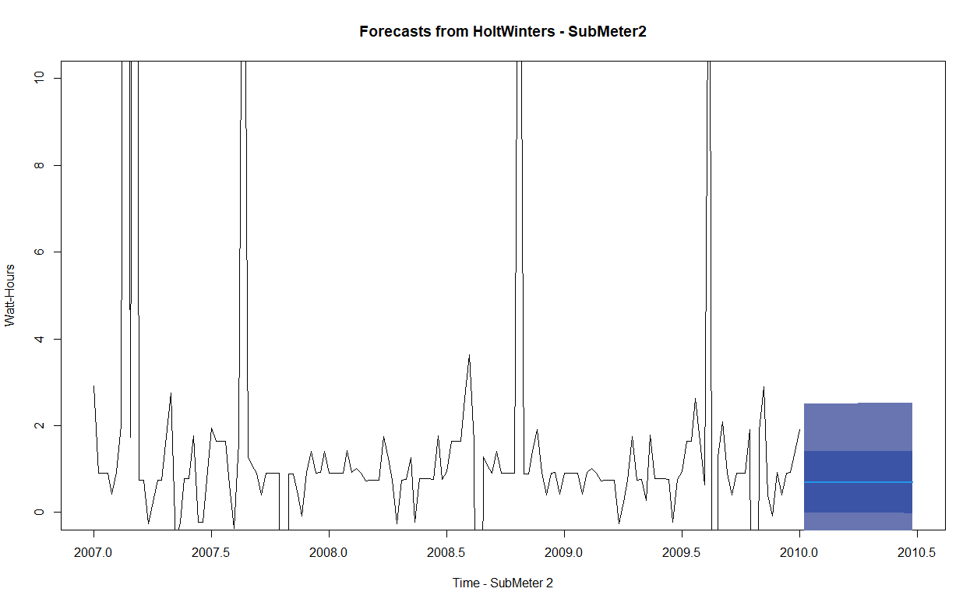
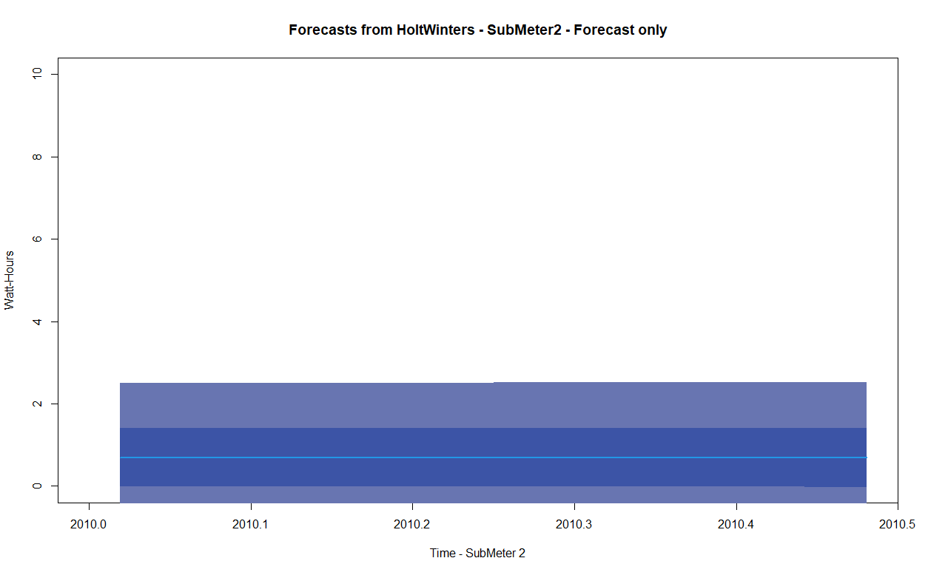
Holt-winters forecasting – submeter 2
These charts show the adjusted forecast for Submeter 2 (Laundry Room), after removing the seasonal component
Charts show confidence level of 10 (the dark blue area) and 25 (the light blue area)
Original data is based only on data from Mondays at 8:00pm for 2007-2009

Slide 11
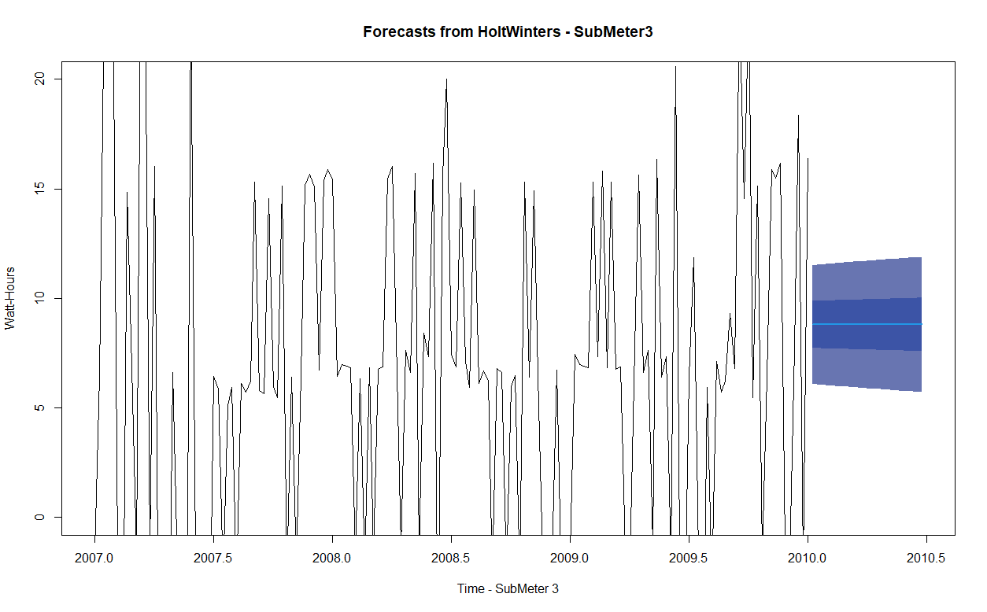
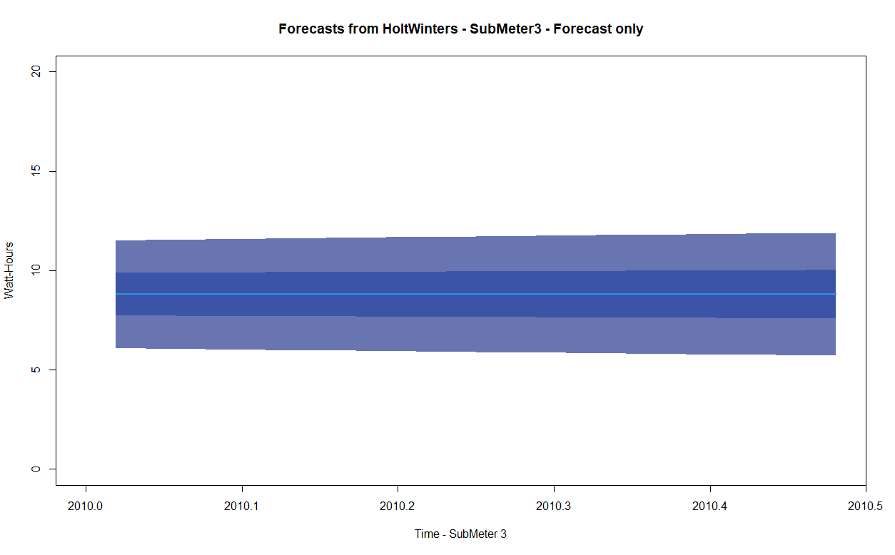
Holt-winters forecasting – submeter 3
These charts show the adjusted forecast for Submeter 3 (Water Heater & AC), after removing the seasonal component
Charts show confidence level of 10 (the dark blue area) and 25 (the light blue area)
Original data is based only on data from Mondays at 8:00pm for 2007-2009

Slide 12
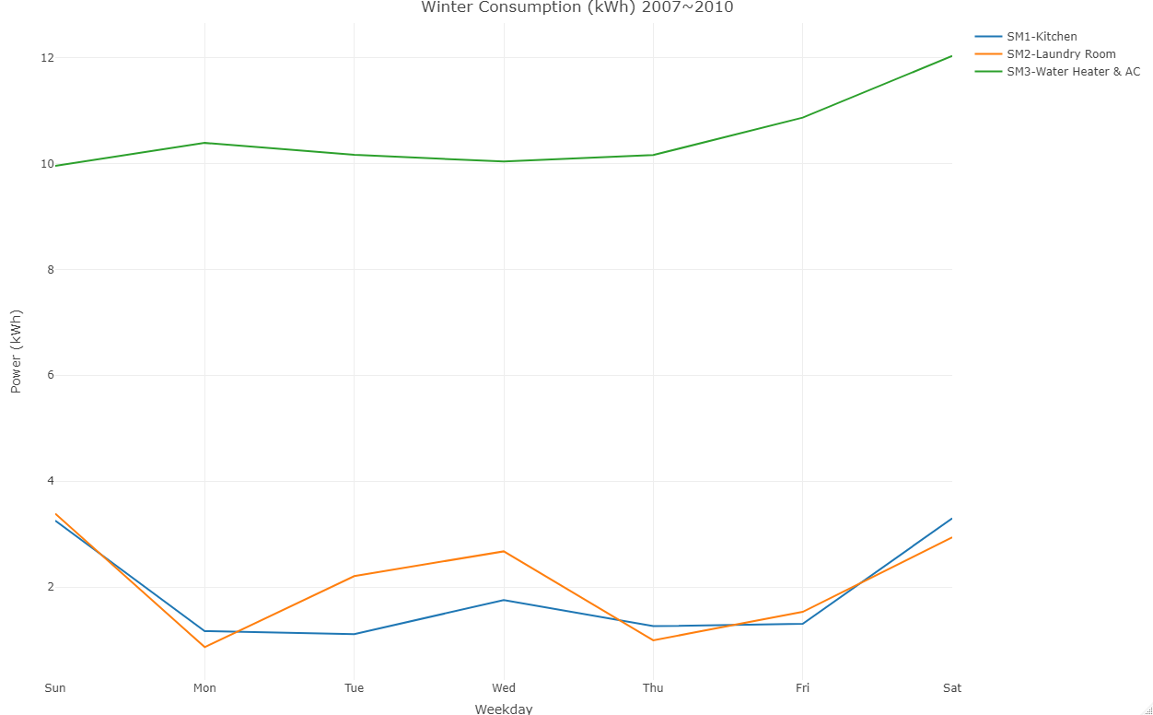
Useful Correlations or Predictions
Submeter 3 makes up the majority of the power consumption
There is correlation between amount of power consumed and the weekday, with higher power consumption on the weekends when people are likely to be at home (see chart to left)
There is correlation between amount of power consumed and the season, with lower power consumption during the summer months (July-August), likely due to higher temperatures (see chart on slide 5)

Slide 13
Summary statement and recommendations
Goal of Project: Finding evidence to support that sub-meters provide owners with ‘useful’ power usage analytics
Summary: Based on the analysis of the submeter power consumption data, we can see that submeters provide useful analytics to homeowners. Additionally, submeters can be used to predict future energy consumption, which can be used to help reduce energy consumption and result in monetary savings.
Recommendations based on visualizations and analysis:
Install submeters in the new ‘Smart Home’ apartment housing development to provide homeowners with power usage analytics
Provide homeowners with Submetering data for their own apartments, as well as average data for other apartments, so they can see how their consumptions compares to their neighbors
Split out the air conditioner and water heater into their own submetering attributes, since these make up most of the total power consumption
Include refrigerator in Submetering 1, with the other kitchen appliances
Add outside temperature to the dataset, to see correlation between power consumption and weather. This could help improve the future predictions and be used to reduce energy consumption.

Slide 14
Lessons Learned
I learned that when you are dealing with such a large dataset, it is essential to create subsets of your data to focus on time periods that provide value
I learned that it is important to increase the granularity when looking at visualizations, otherwise there is too much data to see valuable insights
I learned that some subsets are not helpful. For example, after looking at data by day and week, I decided to look at data by hour. However, there were no patterns within the data, and I needed to choose a different subset (year) to get insights.
I learned that it was important to do some independent research about appliance power consumption, to be able to analyze the data (especially for Submeter 3 – water heater & AC). I had no idea that water heaters run from 3-5 hours per day, but this info helped me understand which peaks in the Submeter 3 consumption aligned to the water heater vs. the AC.
I learned that when looking at time series data, it is important to decompose the time series data into trend, seasonal, and irregular components.
I learned that if there is a strong seasonal component to the time series data, you need to remove that component when performing forecasting. Otherwise, your forecast won’t be as accurate.

Slide 15
Thank you for partnering with iot analytics!

